Slide 1
良渚文化遗址的相关数据调查研究与再演变 (Investigation and Re-evolution of Relevant Data of Liangzhu Cultural Relics)
Group Members：
曾维佳Weijia 、于艾文Aiwen、叶思琪Siqi

Slide 2
Quick description
对良渚文化从有记录开始到逐渐消亡的这个过程中数据的逐渐演变进行探讨和思考。以出土文物为撬点，通过一个单线的顺序，用一种信息交织成的方式，有一个较明显的时间线的分支与主干共同组成，一上一下呼应对照的装置。
The gradual evolution of the data of Liangzhu Culture from the beginning of the record to the gradual demise is discussed and considered. Taking the unearthed cultural relics as a point, through a single-line sequence, using a kind of information interweaving, there is a more obvious timeline branch and the trunk together, and the device that corresponds to the comparison.

Slide 3
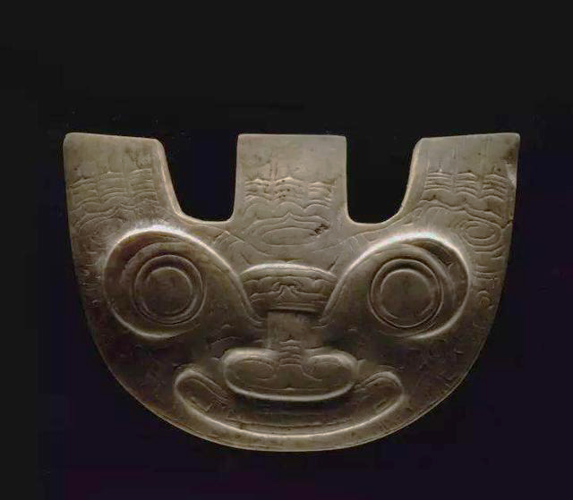
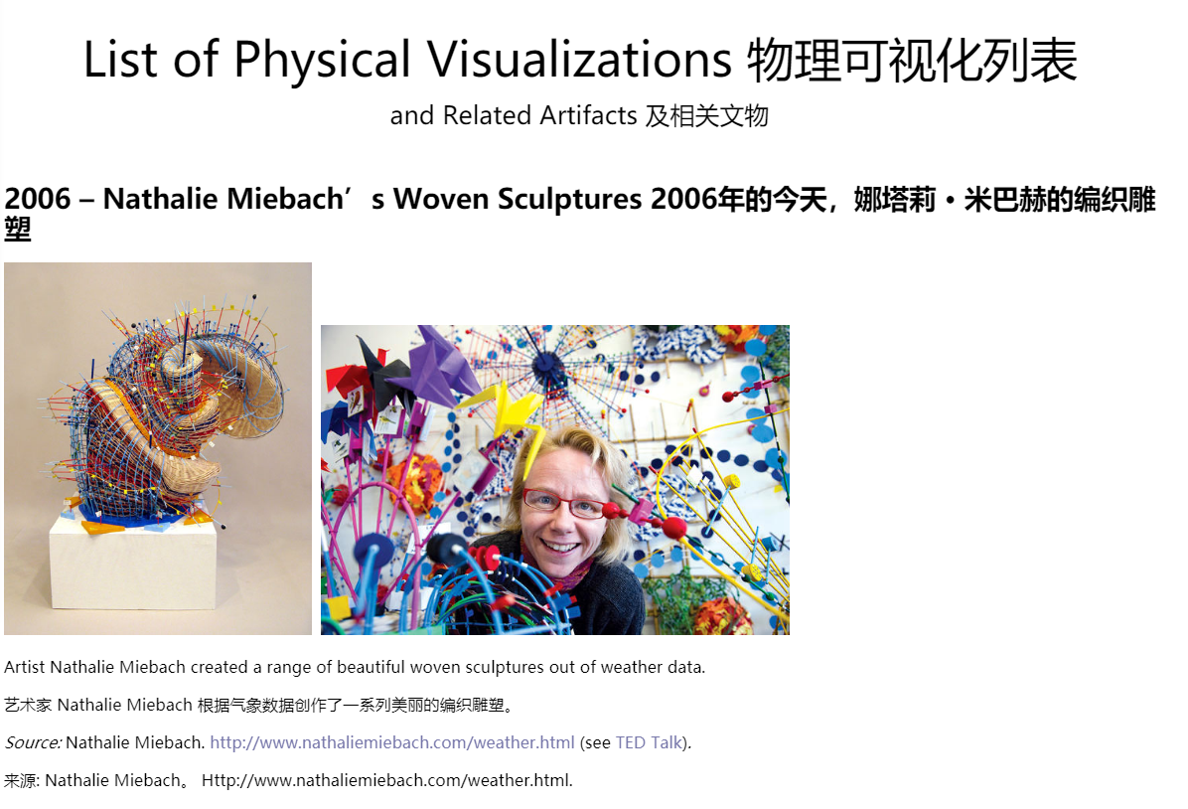
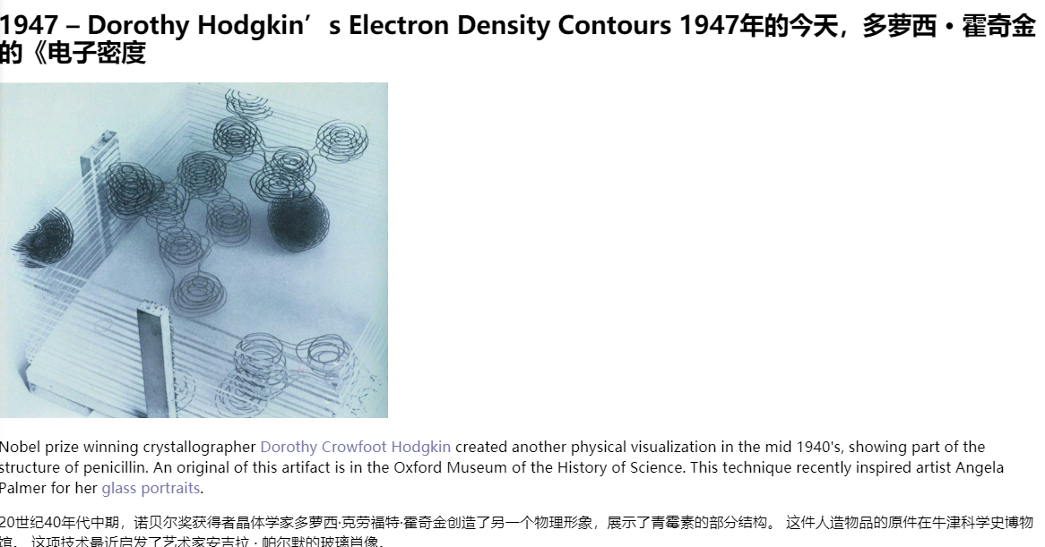
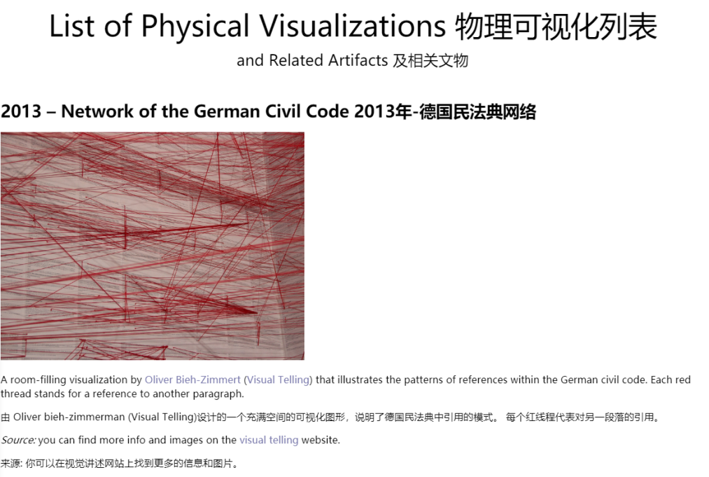
Inspiration

Slide 4
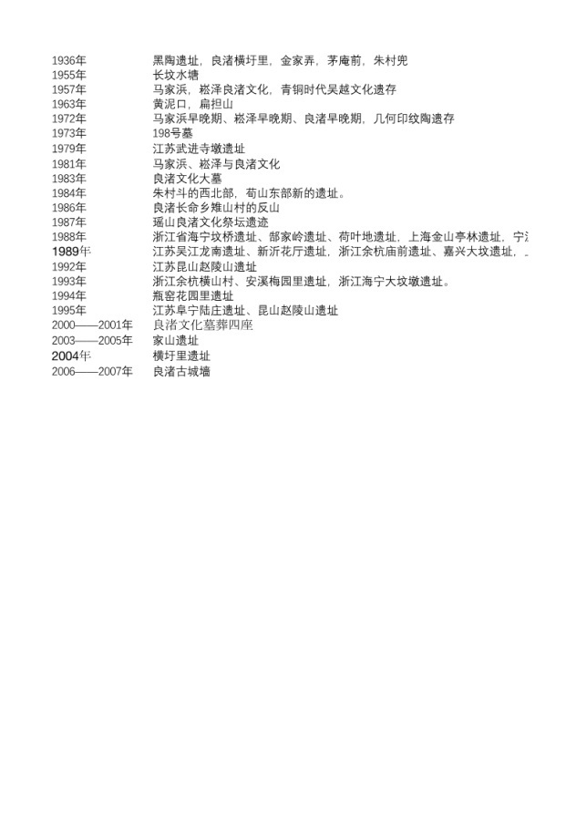
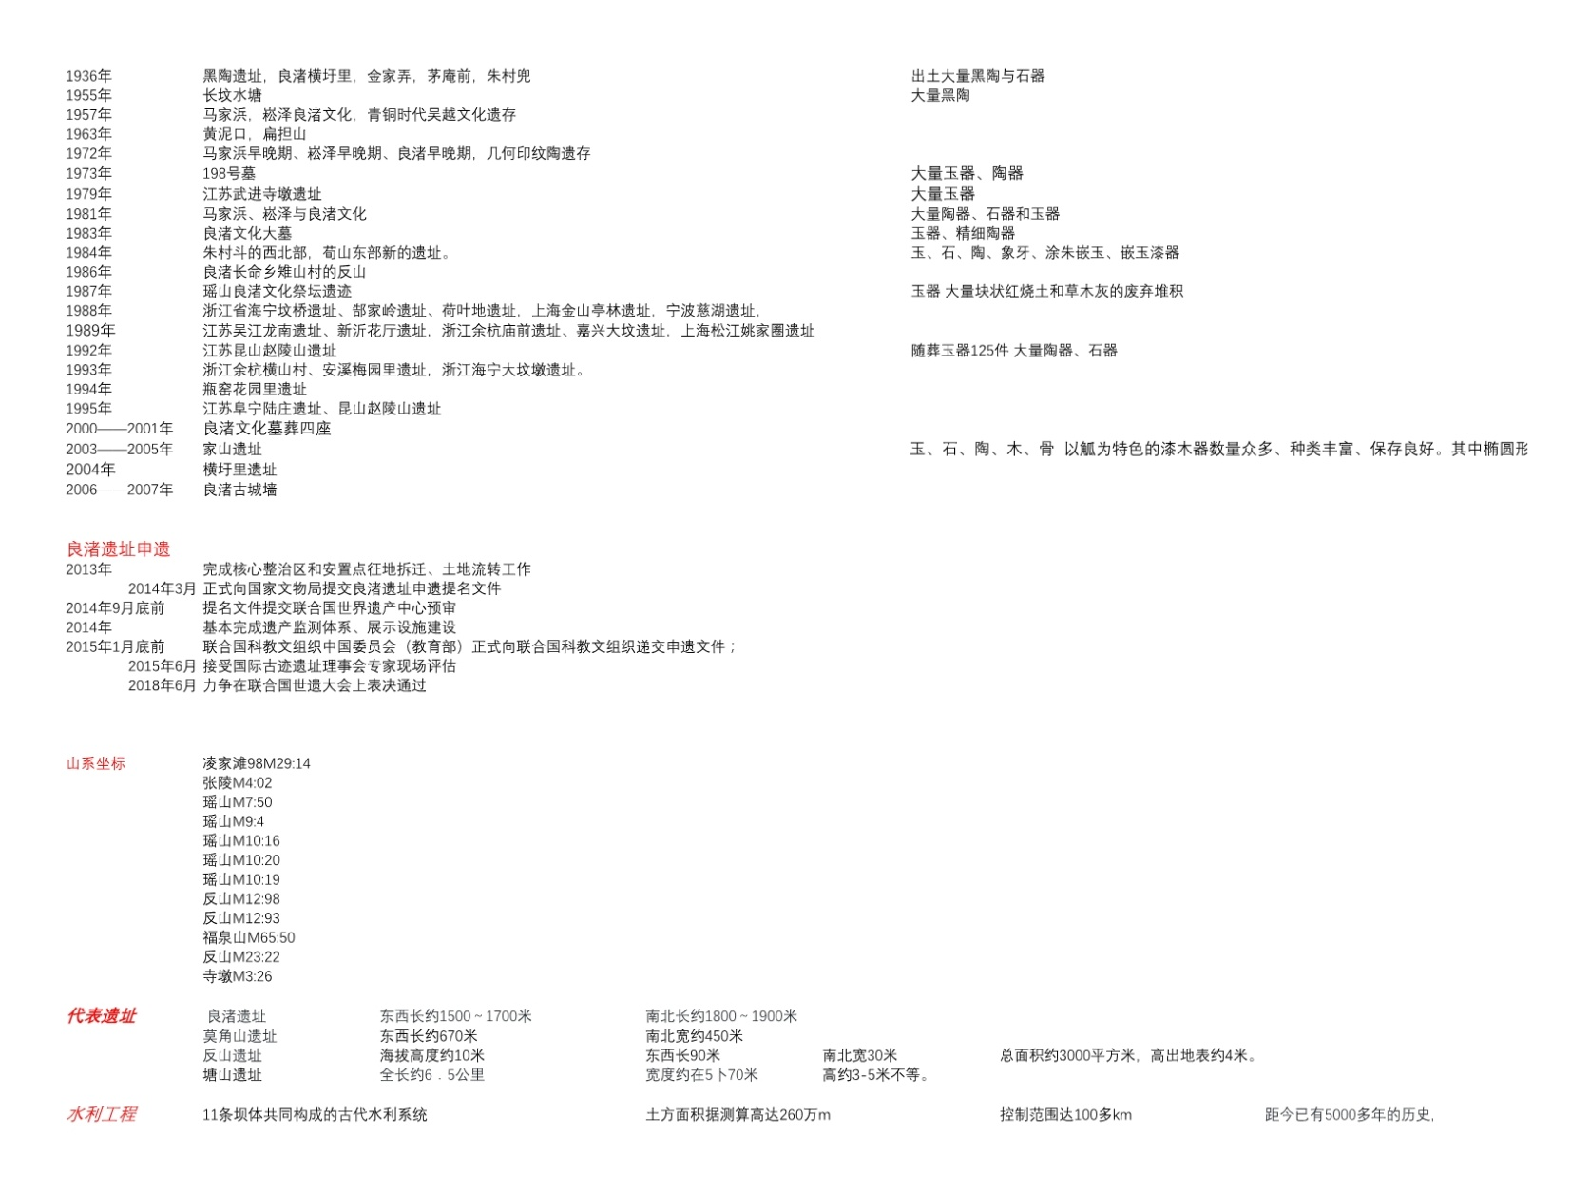
Data we will use

Slide 5
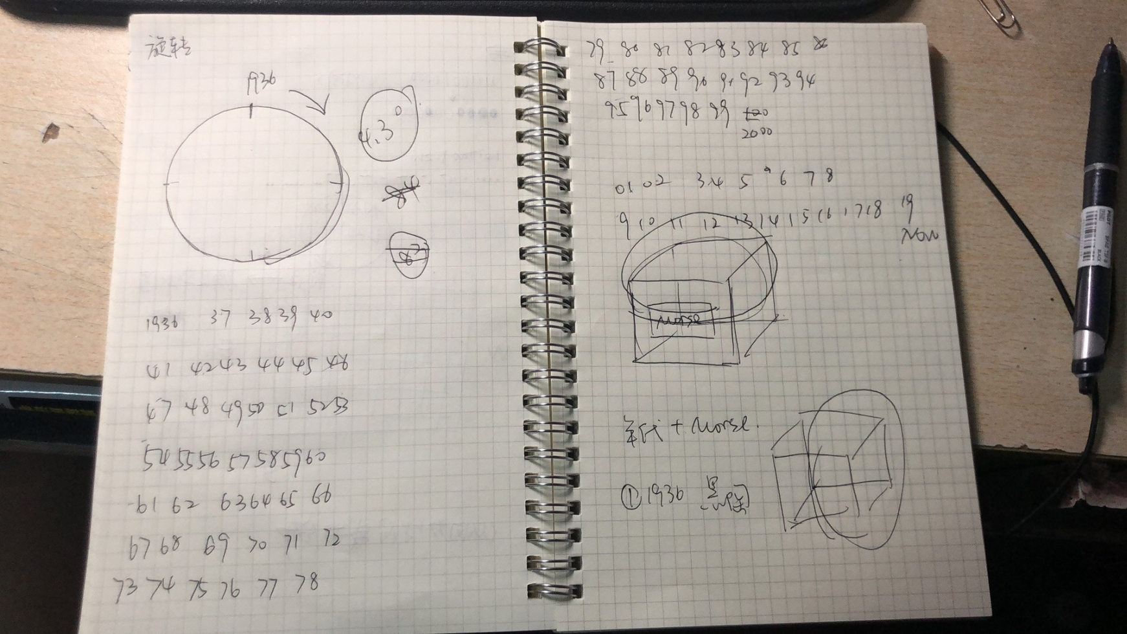
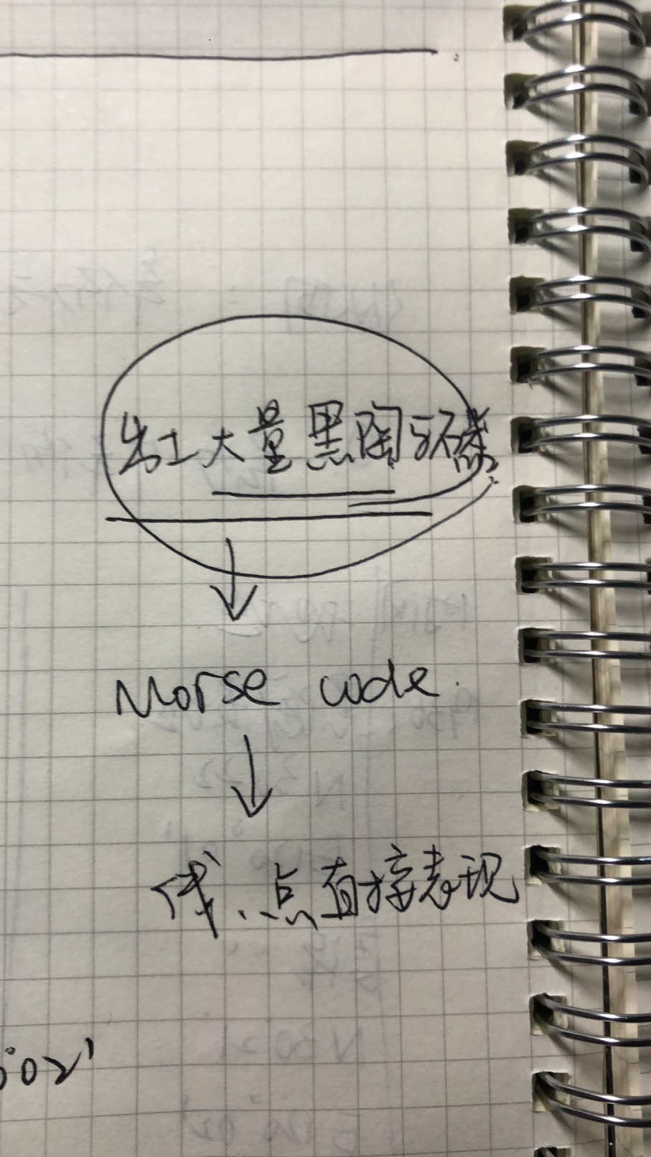
How we will translate the data?

Slide 6
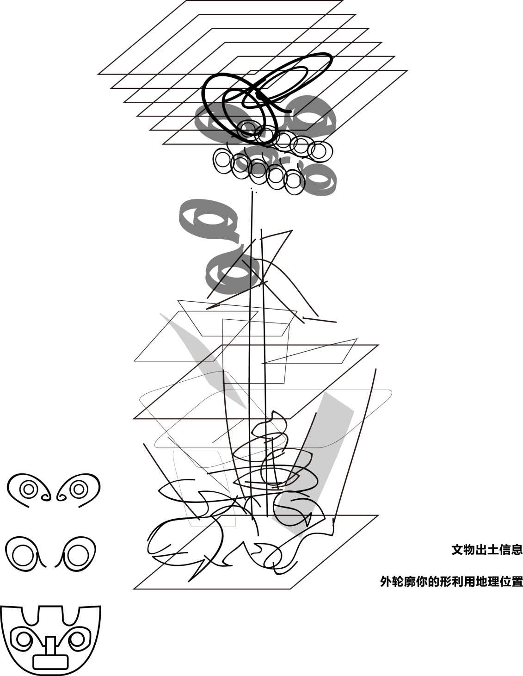
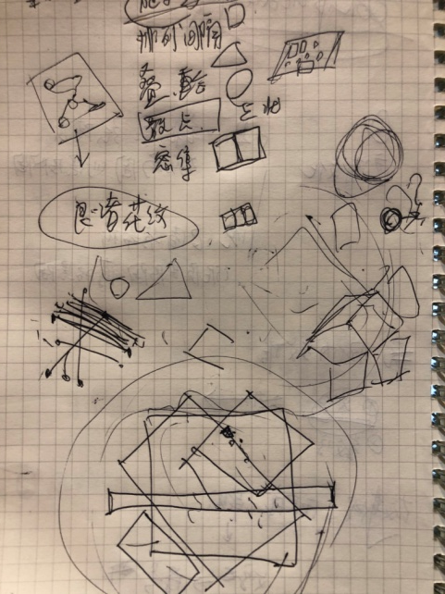
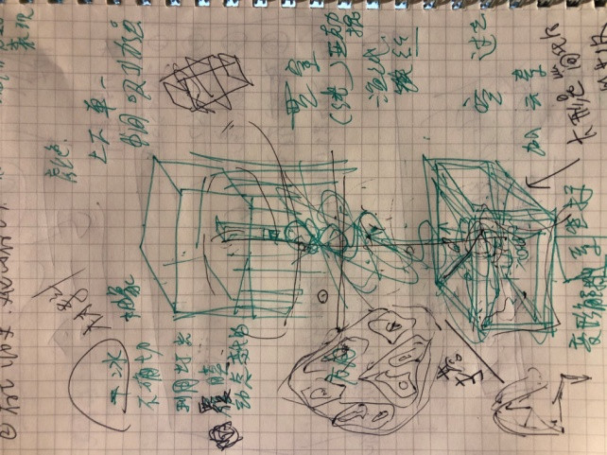
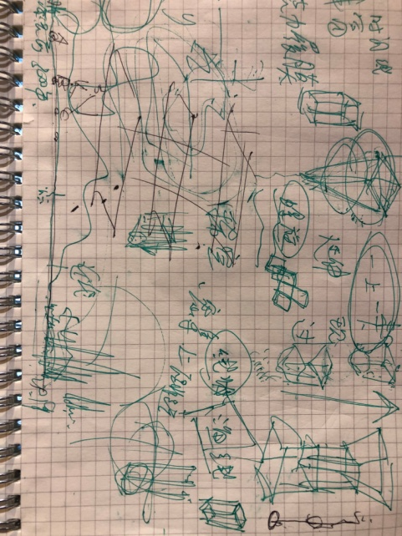
Form Sketches

Slide 7
Timeline for Completion
18~19 做出相应数据转换图
19~21准备材料，打印，雕刻初稿
21~25 进行组装，进行调整
25~27 进行整体的调整

Slide 8
Thank you

